Slide 1

Capstone Project
By Kate Jorjoliani
April 30, 2024

Slide 2
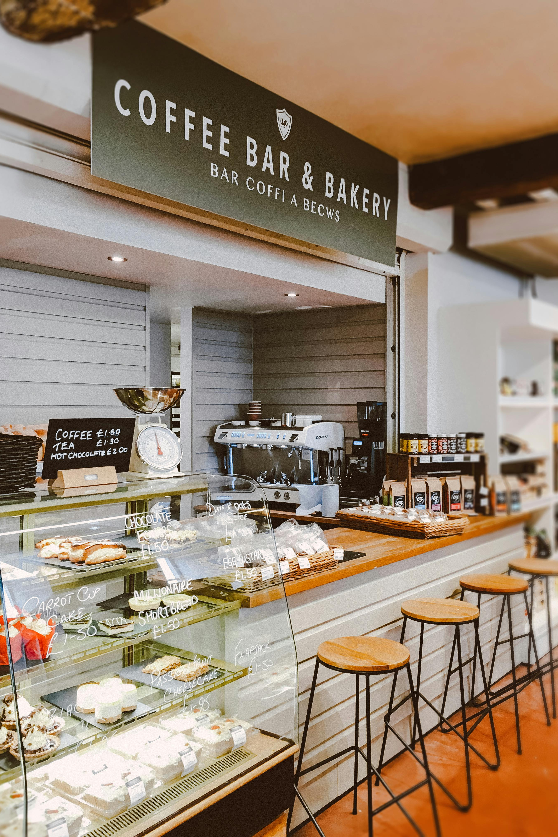
Introduction
We wish to open a coffee shop business in NYC
Need market analysis
Objective:
Data Extraction
Data Exploration
Data Analysis
Conclusions/Recommendations

Slide 3
Data Extraction
Extracted data using the Yelp API to get the relevant data needed for the analysis
Dataset includes Name, Rating, Review count, and Address of popular coffee shops in NYC

Slide 4
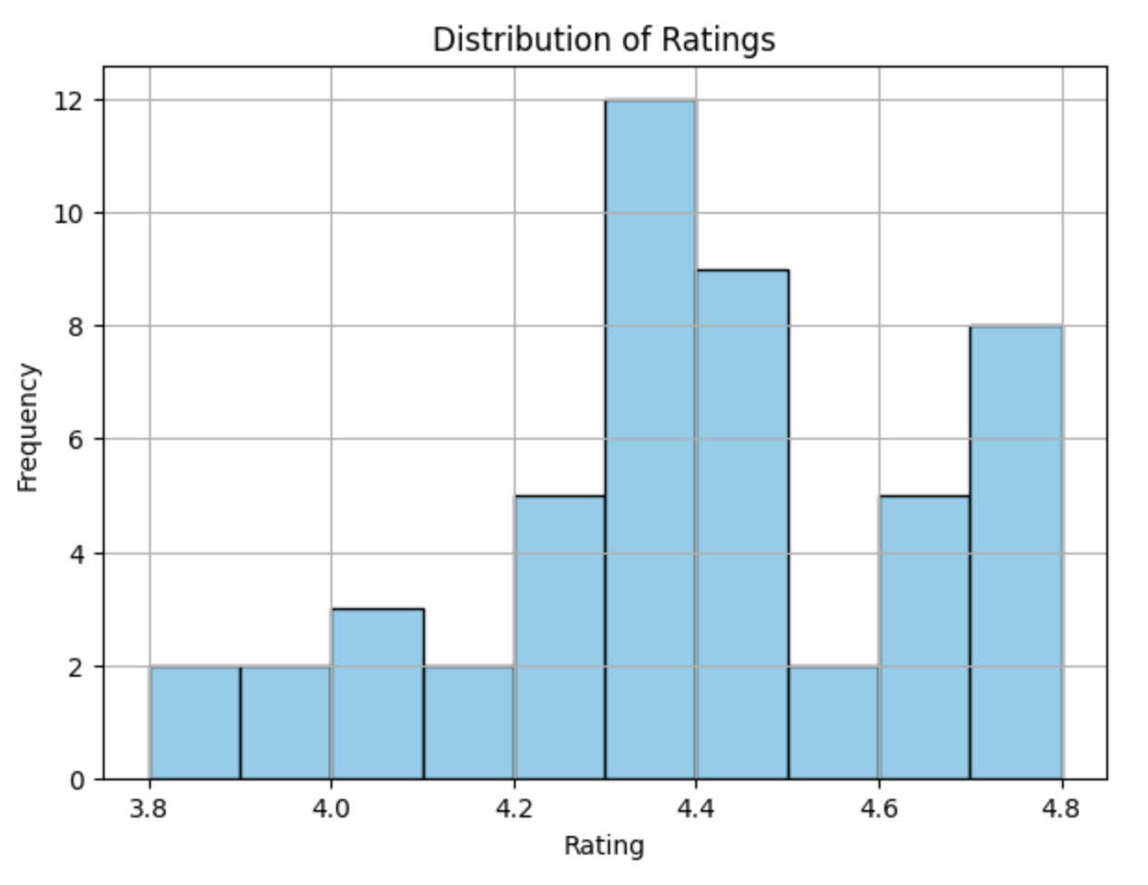
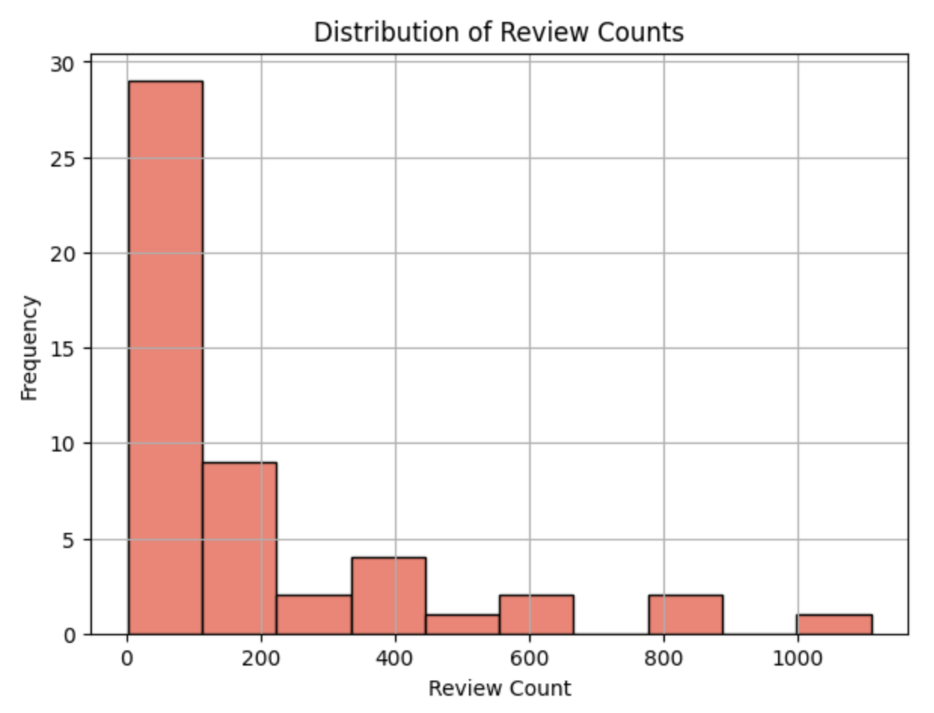
Data Exploration
Most ratings are around 4.3
Most review counts are around 100
Histogram plots for distribution

Slide 5
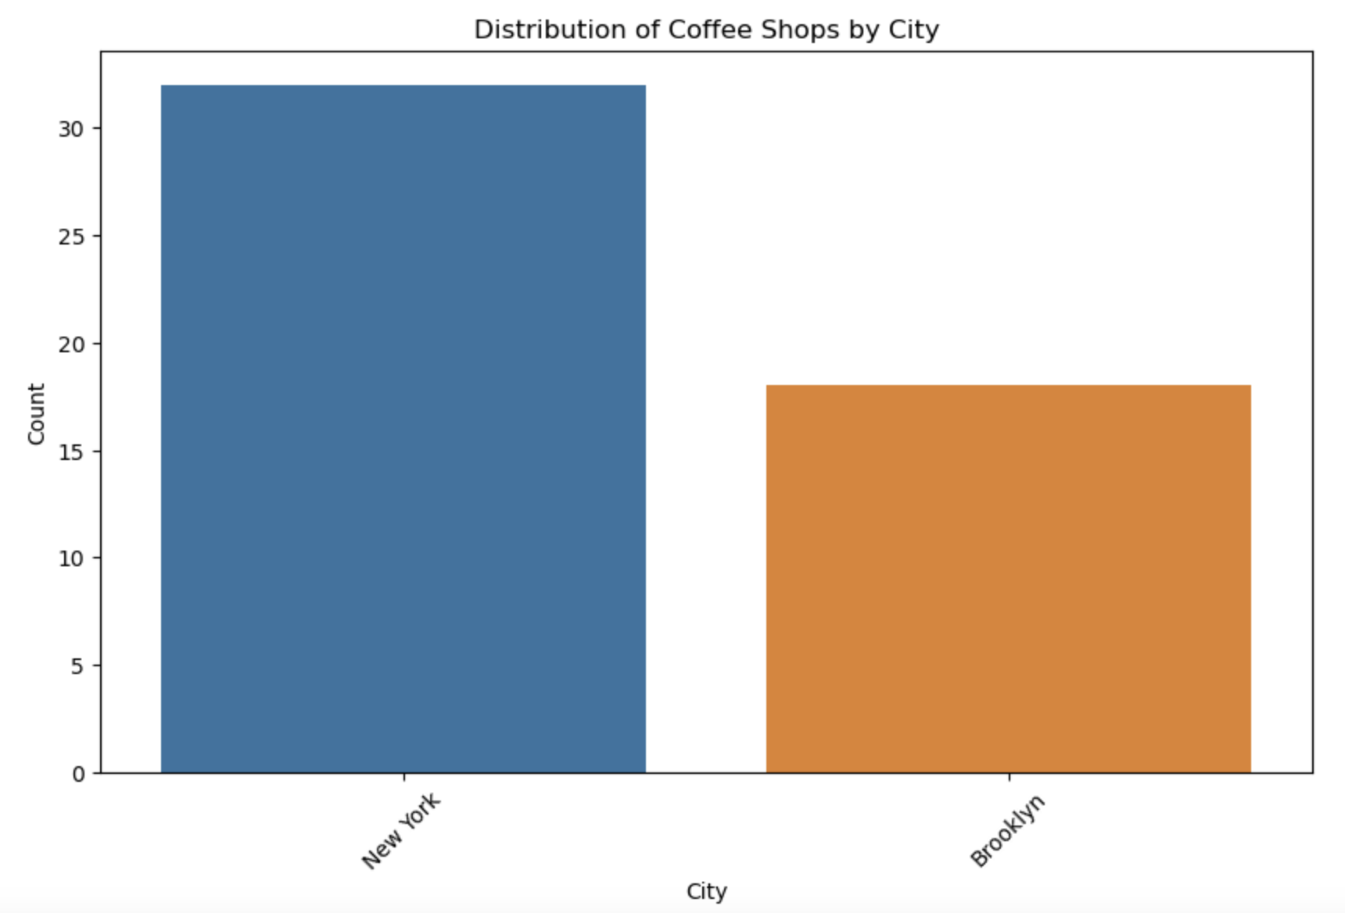
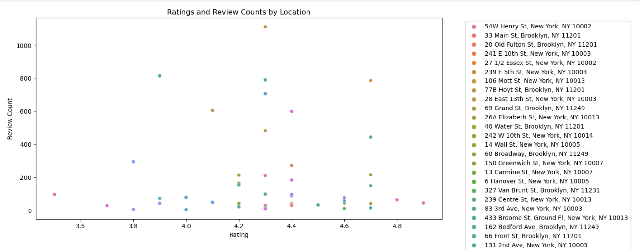
Data Exploration
Manhattan has more coffee shops than Brooklyn
Mott St. has the highest review counts
Henry St. has the highest ratings
Bar plot and scatterplot for further exploration

Slide 6
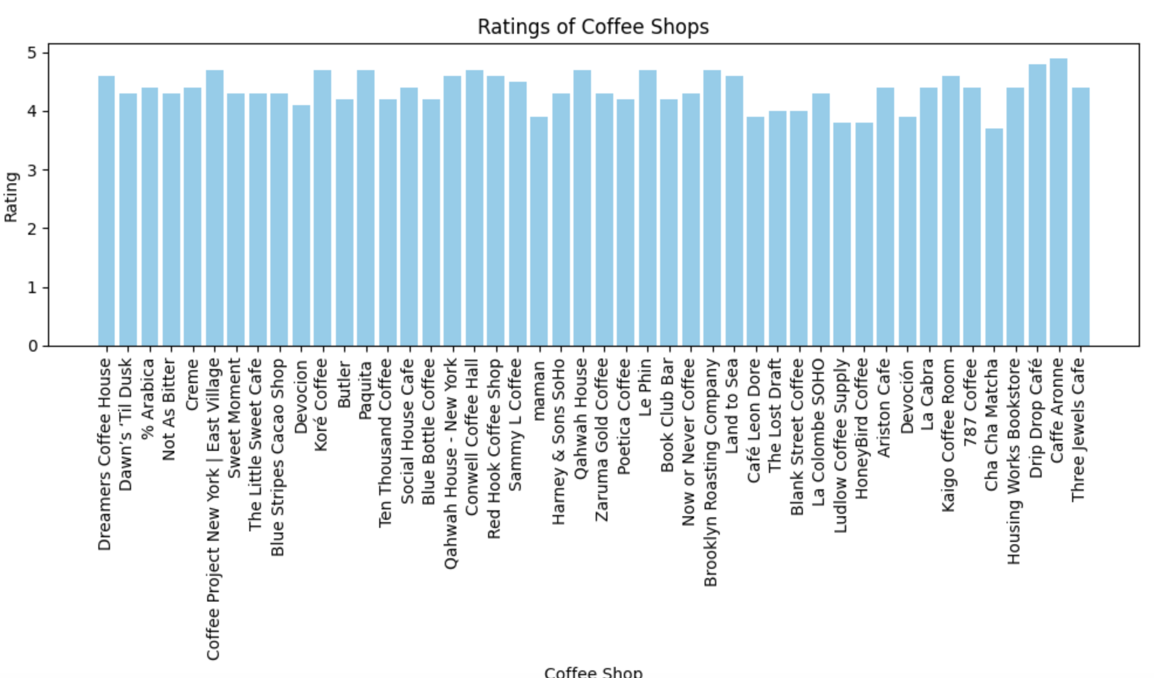
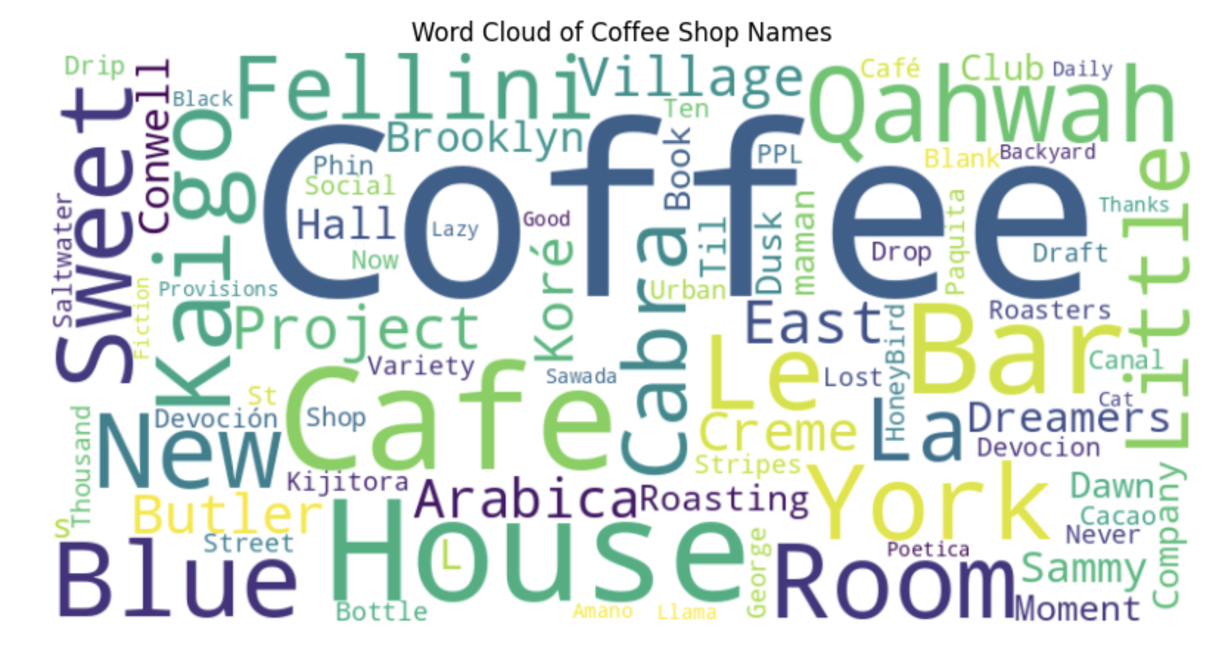
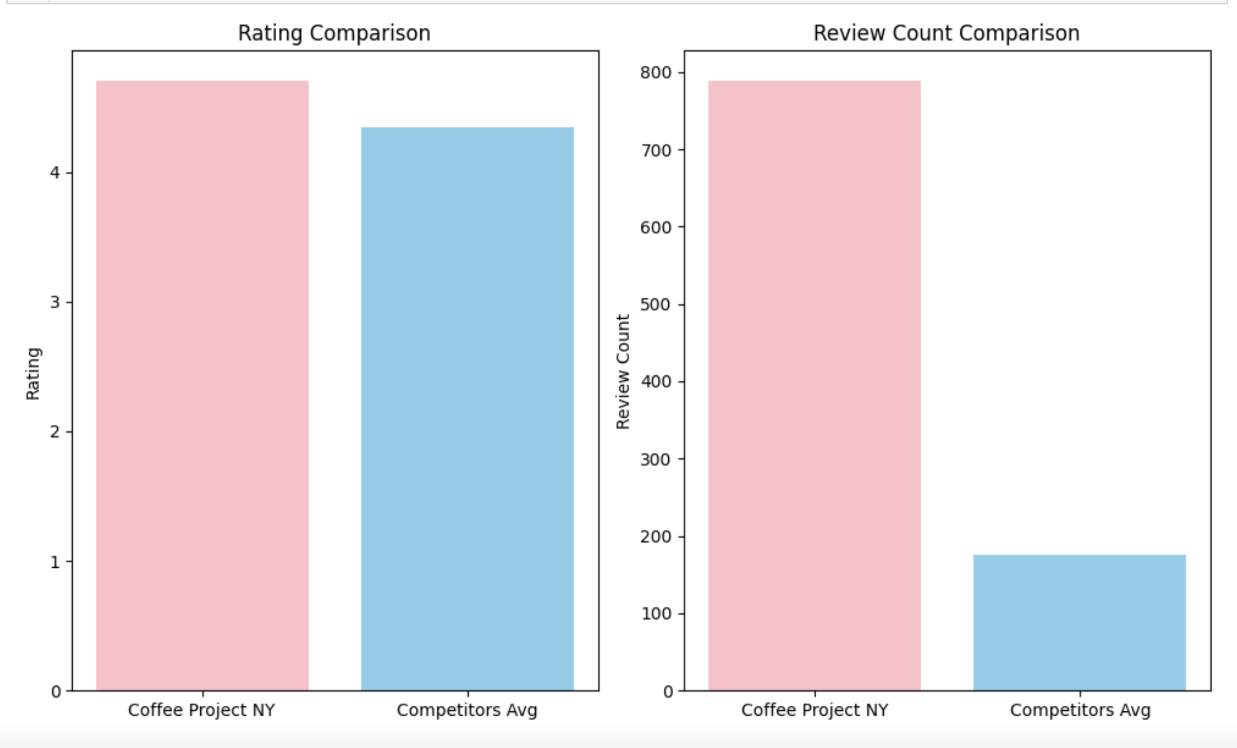
Data Exploration
“Coffee Project NY | East Village” is the most popular coffee shop with the highest ratings (based on analysis not the plot)
Word “Coffee” is the most mentioned word in the names of coffee shops in NY
Text Mining & Competitor Analysis

Slide 7
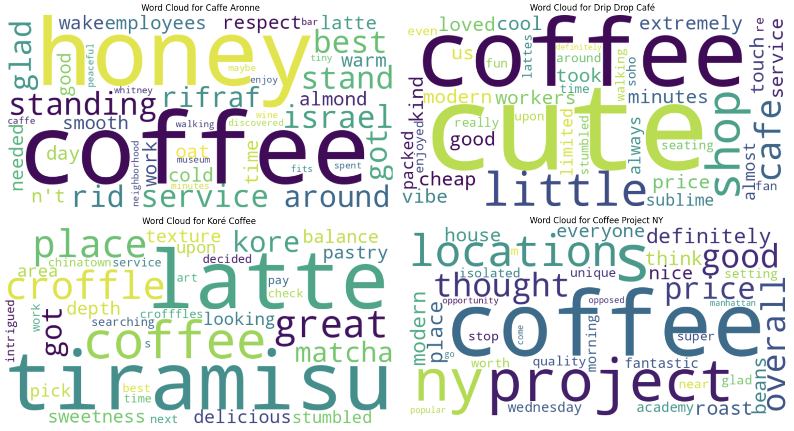
Data Exploration
Analyzing reviews from some of the best NY coffee shops
Text analysis
Most frequent words in reviews:
Roast beans
Honey
Tiramisu
Latte
Great matcha
sweetness
Nice setting
Modern place

Slide 8
Data Analysis
Preprocessed the data
Visually explored the dataset analyzing ratings, reviews, review counts, and geographic distribution of coffee shops in NYC
Identified naming trends through text mining

Slide 9

Conclusions/Recommendations
Location: consider opening the shop in Brooklyn rather than Manhattan
Explore the uniqueness of branding
Importance of customer satisfaction. Use text analysis by identifying most popular trends and implement them in the new business

Slide 10

Thank You!
Questions?

